Slide 1
Sacramento OWASP Meetup
March 2020
Joubin Jabbari

Slide 2
Agenda
Delay to make sure everyone can join
Community Questions and Comments
Intro to Threat Modeling
Resources

Slide 3
Threat Modeling

Slide 4
What is Threat Modeling
A systematic approach to identifying issues in the software
Can be done as an activity or an engagement

Slide 5


Keep in mind
No Threat Model is ever complete
No Threat Model is ever 100% accurate

Slide 6
Practice
Threat Agent:
Threat Surface:
Attack Goal:
Attack:
Mitigation:
Recommendations:
Randoms on the street
Door that doesn’t lock
Steal the content of the car or the car
Open the broken door / hot wire the car
Car requires a chip on the key
I live in a safe neighborhood
Fix the lock (is the car worth it)
Can you park it in a garage
Put a steering Wheel Lock
You have a car
Car door doesn’t lock
You park on the street

Slide 7
Threat Modeling Approaches
Attacker Centric
Architecture/System Centric
Asset Centric

Slide 8
Threat Modeling Methods
STRIDE
PASTA
LINDDUN
CVSS
Attack Tree
Persona non Grata
Security Cards
hTMM
Quantitative TMM
Strike
VAST Modeling
OCTAVE

Slide 9
STRIDE
Spoofing
Tampering with Data
Repudiation
Information Disclosure
Denial of Service
Elevation of Privilege

Slide 10
VAST
Visual
Agile
Simple
Threat Modeling

Slide 11
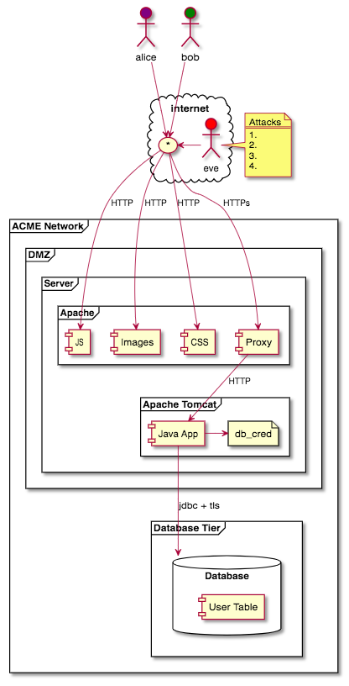
Try it!

Slide 12
Try it!

Slide 13
Try it!
Spoofing
Tampering with Data
Repudiation
Information Disclosure
Denial of Service
Elevation of Privilege

Slide 14
Resources
OWASP: Application Threat Modeling
CMU: Threat Modeling Resources
Adam Shostack
Threat Modeling Training on LinkedIn

